Slide 1
Management Information Systems
Organization and Information Systems

Slide 2
What is an Information System?
Control of System Performance
Input of
Data
Resources
Processing
Data
Output of
Information
Products
Storage of Data Resources
Notes:
Introduction to Information Systems
Chapter 1
© 2002 McGraw-Hill Companies

Slide 3
Information Systems
Information system: Three activities produce information organizations need
  Input: Captures raw data from organization or external environment
  Processing: Converts raw data into meaningful form
  Output: Transfers processed information to people or activities that use it
Feedback:
  Output returned to appropriate members of organization to help evaluate or correct input stage

Slide 4
Information Systems
An information system depends on the :
Resources of people (end users and IS specialists)
Hardware (machines and media)
Software (programs and procedures)
Data (data and knowledge bases)
Networks (communications media and network support)

Slide 5
Components of IS
People Resources. People are required for operation of all ISs. People resources include:
  End Users : Use the IS or the information it produces.
  IS Specialists: These people develop and operate the IS.

Slide 6
Components of IS
Hardware Resources. These include all the physical devices and materials used in information processing, including all machines and data media. Key components include:
  Computer Systems. These are the CPUs and their related peripherals, such as terminals and networked PCs.
  Computer Peripherals. These are input and output devices like keyboards, monitors, and secondary storage.
  Telecommunications Networks. These are the computer systems interconnected by various telecommunications media such as modems.

Slide 7
Components of IS
Software Resources. These include all sets of information processing instructions. Software resources include:
  System Software. This controls the computer.
  Application Software. These are for a specific end user task, such as word-processing.
  Procedures. These are the operating instructions for the people who use the IS.
Data Resources. Data is both the raw material of and among the most valuable organizational resources in the IS. Data can be in alphanumeric, text, image and/or audio form. Data are typically organized into either Databases - which hold processed and organized data; or Knowledge bases - which hold knowledge in a variety of forms such as facts and rules of inference about a given subject.

Slide 8
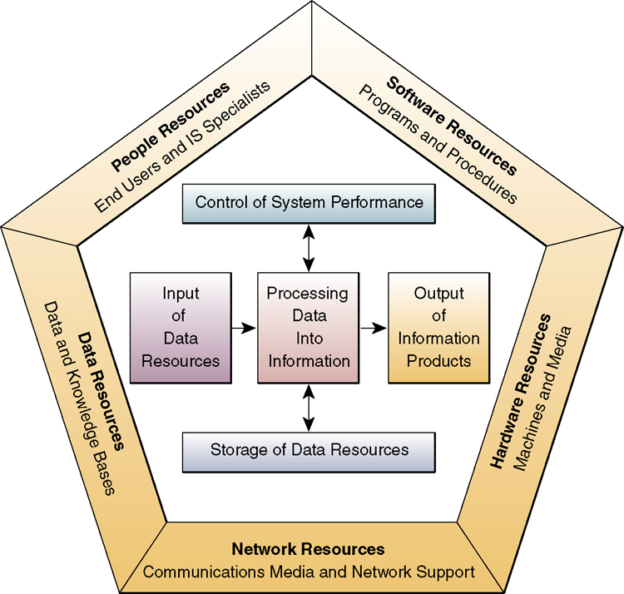
Components of an Information System
Notes:
Introduction to Information Systems
Chapter 1
© 2002 McGraw-Hill Companies

Slide 9
Organizations and Information Systems
What is an organization?
  Technical definition:
    Stable, formal social structure that takes resources from environment and processes to produce outputs.
    A formal legal entity with internal rules and procedures, as well as a social structure

Slide 10
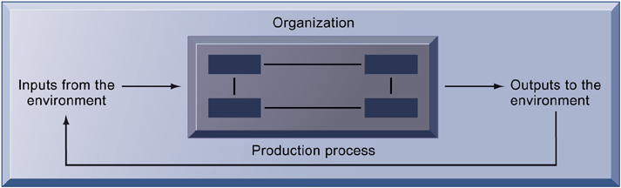
Organizations and Information Systems
The Technical Microeconomic
Definition of the Organization
In the microeconomic definition of organizations, capital and labor (the primary production factors provided by the environment) are transformed by the firm through the production process into products and services (outputs to the environment). The products and services are consumed by the environment, which supplies additional capital and labor as inputs in the feedback loop.

Slide 11
Organizations and Information Systems
Information technology and organizations influence one another
  Complex relationship influenced by organization’s structure, business processes, politics, culture, environment, and management decisions

Slide 12
Organizations and Information Systems
Organizational environments:
  Organizations and environments have a reciprocal relationship
  Organizations are open to, and dependent on, the social and physical environment
  Organizations can influence their environments
  Environments generally change faster than organizations
  Information systems can be instrument of environmental scanning, act as a lens

Slide 13
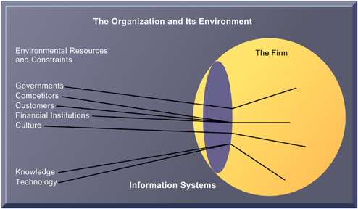
Organizations and Information Systems
Environments and Organizations
Have a Reciprocal Relationship
Environments shape what organizations can do, but organizations can influence their environments
and decide to change environments altogether. Information technology plays a critical role in helping
organizations perceive environmental change and in helping organizations act on their environment.
Figure 3-5

Slide 14
IT/IS and its influence
Why IS ?
  Complexity of the organization
  Large quantity of the data
  Decision taking

Slide 15
IT/IS and its influence
Objectives of IS
  Information provided should be accurate ,timely, right ,to right people and to filter unwanted and unnecessary information
  To provide a set of key performance indicators so that an organization can judge their employees’ performance
  Tracking the performance of the employees

Slide 16
Decision Making and Information Systems
Business value of improved decision making
  Improving hundreds of thousands of “small” decisions adds up to large annual value for the business
Types of decisions:
  Unstructured: Decision maker must provide judgment, evaluation, and insight to solve problem
  Structured: Repetitive and routine; involve definite procedure for handling so they do not have to be treated each time as new
  Semistructured: Only part of problem has clear-cut answer provided by accepted procedure

Slide 17
Decision Making and Information Systems
Senior managers:
  Make many unstructured decisions
  E.g. Should we enter a new market?
Middle managers:
  Make more structured decisions but these may include unstructured components
  E.g. Why is order fulfillment report showing decline in XYZ product?
Operational managers, rank and file employees
  Make more structured decisions
  E.g. Does customer meet criteria for credit?

Slide 18
Major Roles of Information Systems
Support
Strategies for
Competitive Advantage
Support
Business Decision Making
Support
Business Processes and Operations
Notes:
Introduction to Information Systems
Chapter 1
© 2002 McGraw-Hill Companies

Slide 19
Major Roles of Information Systems
Support Business Operations. From accounting to tracking customers' orders, information systems provide management with support in day-to-day business operations.
As quick response becomes more important, the ability of information systems to gather and integrate information across business functions is become crucial.

Slide 20
Major Roles of Information Systems
Support Managerial Decision Making. Just as information systems can combine information to help run the business better, the same information can help managers identify trends and to evaluate the outcome of previous decisions. IS helps managers make better, quicker, and more informed decisions.
Support Strategic Advantage. Information systems designed around the strategic objectives of the company help create competitive advantages in the marketplace.

Slide 21
How Information Systems Impact Organizations and Business Firms
Economic impacts
  IT changes relative costs of capital and the costs of information
  Information systems technology is a factor of production, like capital and labor
  IT affects the cost and quality of information and changes economics of information
    Information technology helps firms contract in size because it can reduce transaction costs

Slide 22
How Information Systems Impact Organizations and Business Firms
Organizational and behavioral impacts
  IT flattens organizations
    Decision-making pushed to lower levels
    Fewer managers needed (IT enables faster decision-making and increases span of control)

Slide 23
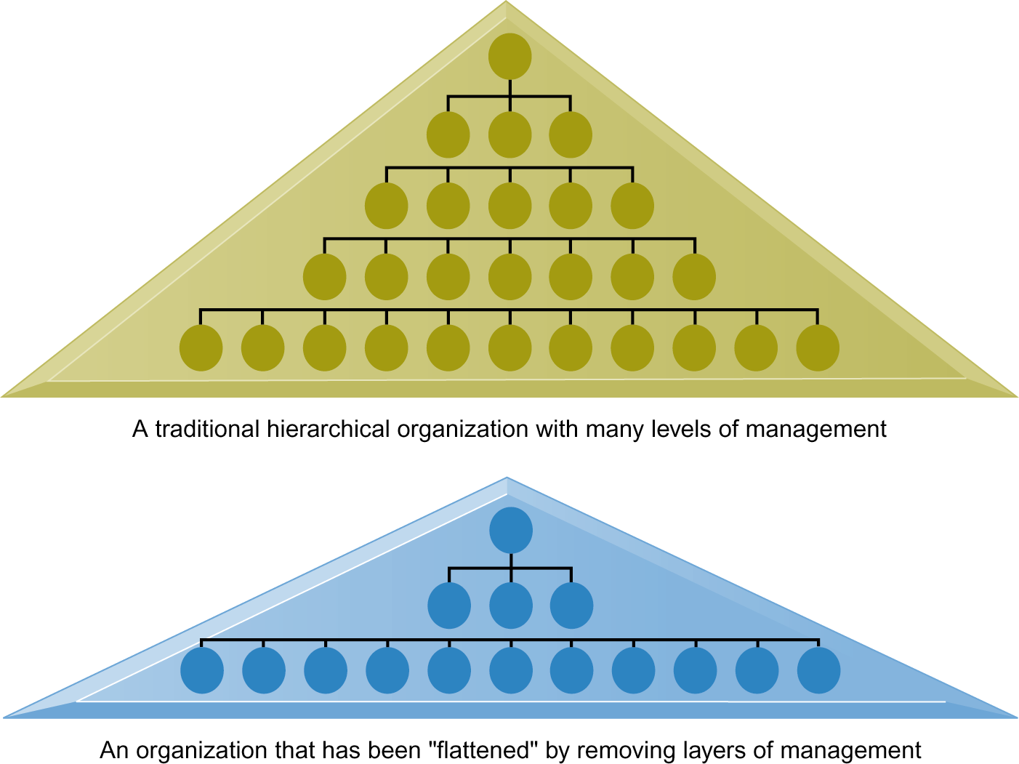
How Information Systems Impact Organizations and Business Firms
Flattening Organizations

Slide 24
Changing Environment And Its Impact on Business
Growing interdependence between ability to use information technology and ability to implement corporate strategies and achieve corporate goals
Business firms invest heavily in information systems to achieve six strategic business objectives:
  Operational excellence
  New products, services, and business models
  Customer and supplier intimacy
  Improved decision making
  Competitive advantage
  Survival

Slide 25
Changing Environment And Its impact on Business
Operational excellence:
  Improvement of efficiency to attain higher profitability
  Information systems, technology an important tool in achieving greater efficiency and productivity
    E.g. Wal-Mart’s Retail Link system links suppliers to stores for superior replenishment system

Slide 26
Changing Environment And Its impact on Business
New products, services, and business models:
  Information systems and technology a major enabling tool for new products, services, business models
    Business model: describes how company produces, delivers, and sells product or service to create wealth
    E.g. Apple’s iPod, iTunes and Netflix’s Internet-based DVD rentals

Slide 27
Changing Environment And Its impact on Business
Customer and supplier intimacy:
  Serving customers well leads to customers returning, which raises revenues and profits
    E.g. High-end hotels that use computers to track customer preferences and use to monitor and customize environment
  Intimacy with suppliers allows them to provide vital inputs, which lowers costs

Slide 28
Changing Environment And Its impact on Business
Improved decision-making
  Managers must use forecasts, best guesses, luck
  Lack of the information Leads to:
      Overproduction, underproduction of goods and services
      Misallocation of resources
      Poor response times
    Poor outcomes raise costs, lose customers

Slide 29
Changing Environment And Its impact on Business
Competitive advantage
  Delivering better performance
  Charging less for superior products
  Responding to customers and suppliers in real time
    E.g. Dell: Consistent profitability over 25 years; Dell remains one of the most efficient producer of PCs in world.
    But Dell has lost some of its advantages to fast followers- HP

Slide 30
Changing Environment And Its impact on Business
Survival
  Information technologies as necessity of business
  May be:
    Industry-level changes, e.g. HSBC’s introduction of ATMs
    Governmental regulations requiring record-keeping
      E.g. Toxic Substances Control Act, Sarbannes-Oxley Act

